Slide 1





ITCS335_Introduction To
E-Business Systems
2/2021

Slide 2
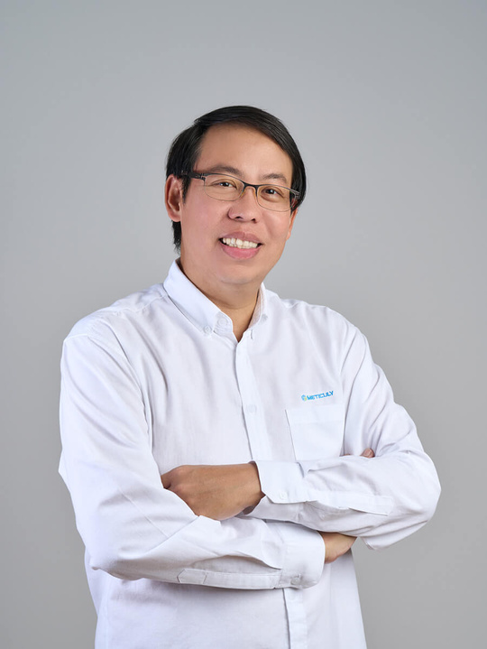
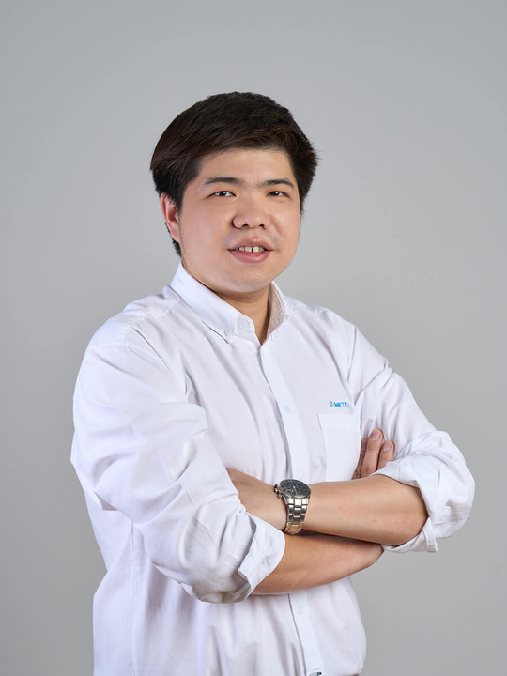
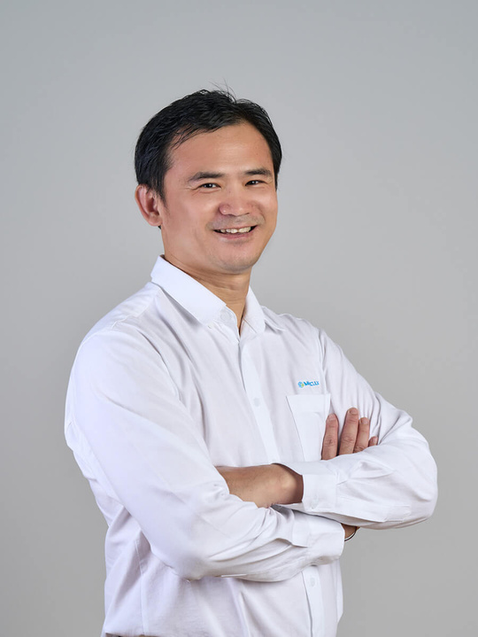
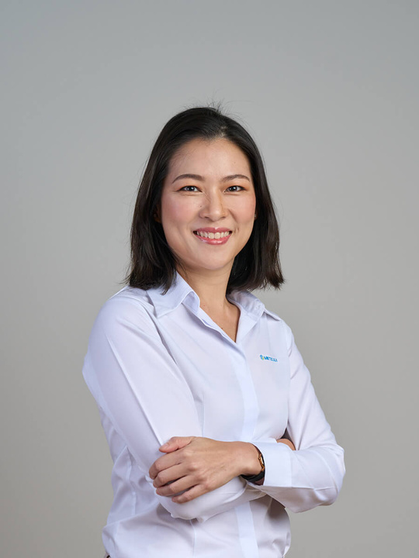
Meticuly Team
Assoc. Prof. Boonrat Lohwongwatana
Assoc. Prof. Chedtha Puncreobutr
Sumate Chaisoorayakan
Peeranoot Lohwongwatana
CFO AND CO-FOUNDER
COO AND CO-FOUNDER
CEO AND CO-FOUNDER
CTO AND CO-FOUNDER
2/2021
01
ITCS335_Introduction To E-Business Systems
2/2021
15

Slide 3

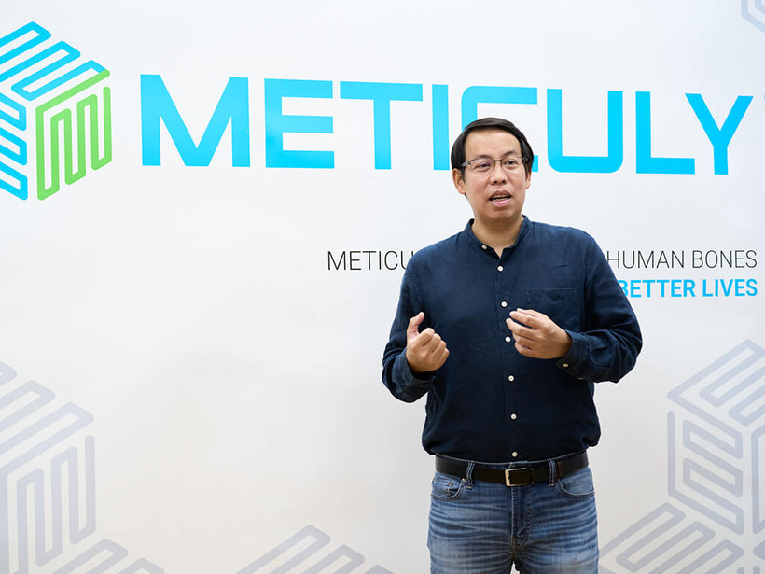
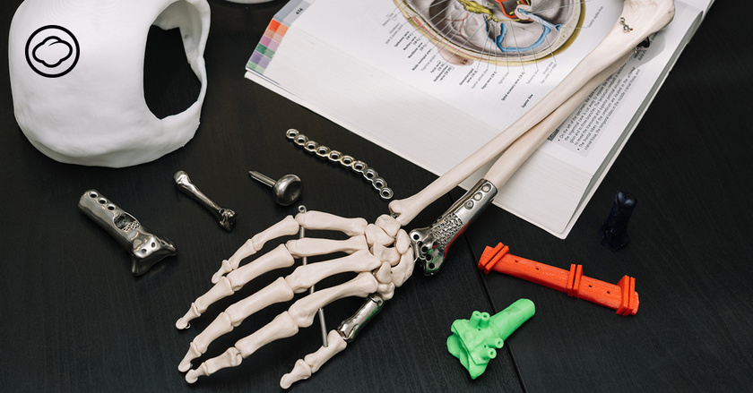
Meticuly was established in 2017 with the 3D Printing technology that works with a medical implant to achieve this with advanced AI-assisted software in high manufacturing, and effective procedures for physicians
2/2021
01
ITCS335_Introduction To E-Business Systems
2/2021

Slide 4





How it works & Value
1) Contact for details of CT scan
- Patient contact for CT protocol
from a sales representative, email, phone.
4) Production of artificial bones by 3D printing
- After completing the production process, Meticuly will check the quality of every implant before shipping.
2) Send CT scan to Meticuly team
- After receiving a valid CT scan,
Meticuly immediately begin the design process.
5) Delivery of surgical materials to the doctor
- Your titanium prosthesis is ready for surgery.
3) Review surgical plans with a doctor
- Meticuly team will be involved in planning the surgery and designing the titanium implant until the model is confirmed by the treating doctor.
2/2021
ITCS335_Introduction To E-Business Systems
01
2/2021
15

Slide 5
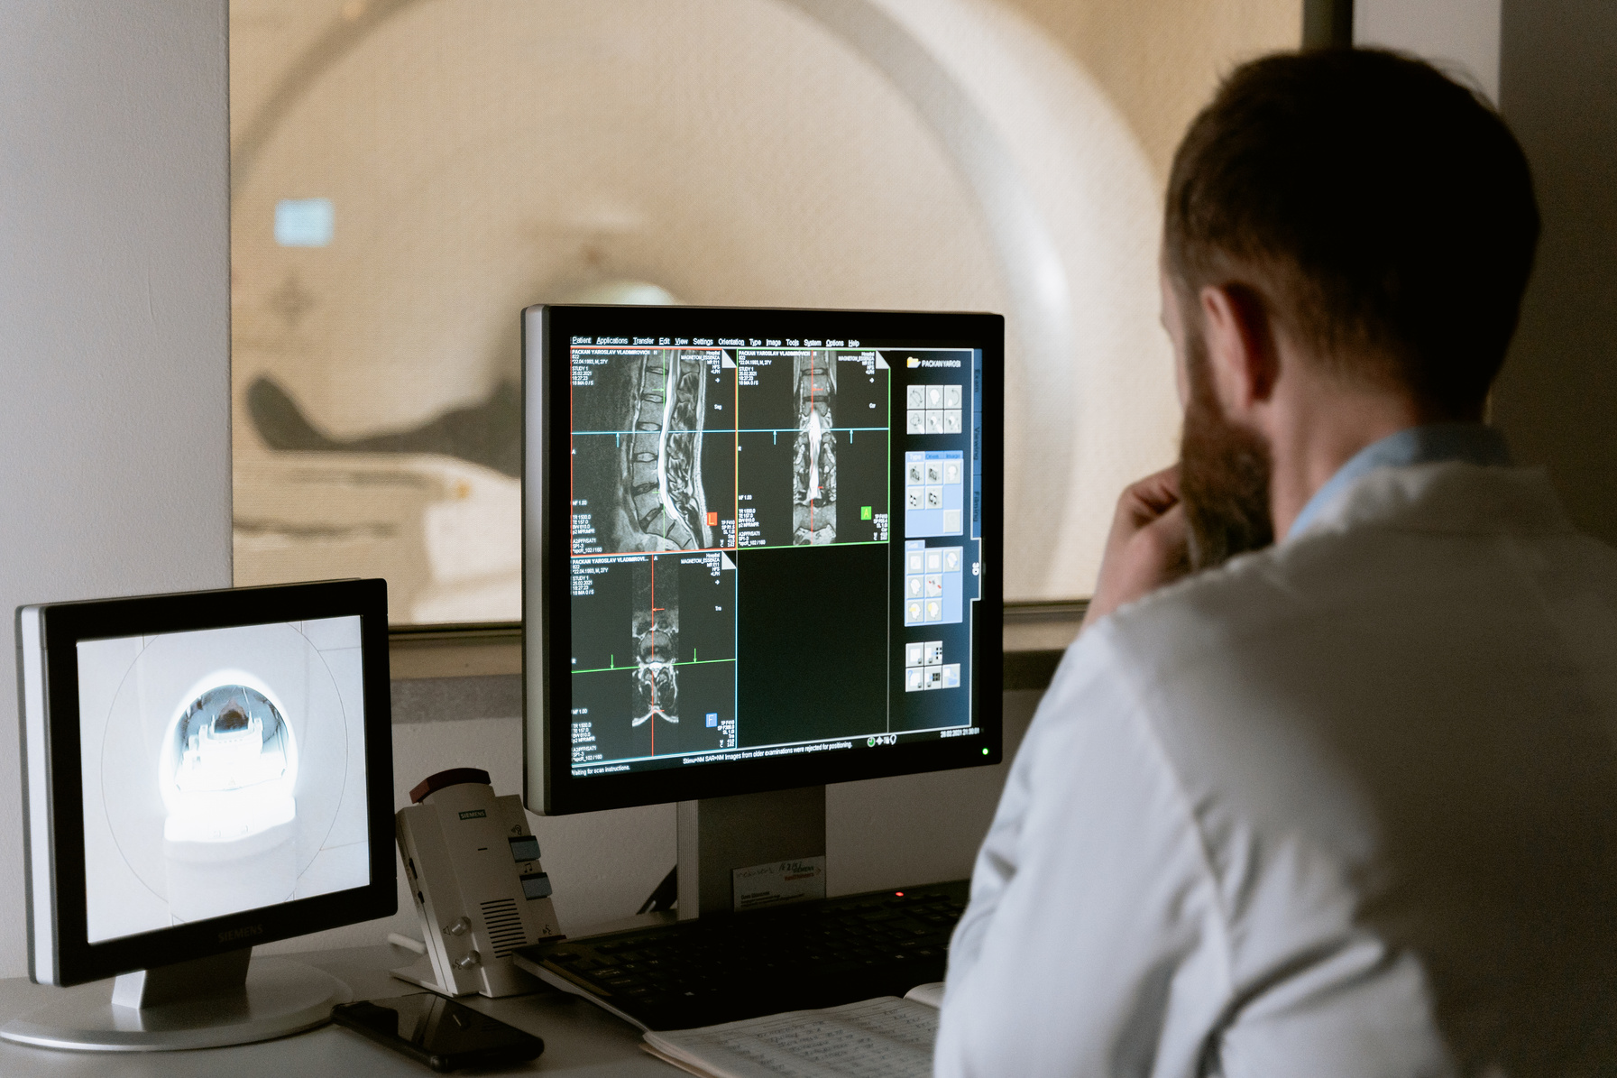
Target Market
For Doctor
Medical profession especially in orthopedic field
For Patients
Bone disease
Patients who want to replace the old bone with new bone.
Patients with fractures and obstacles to surgery.
Group of patients who need to have a surgical positioning device.
2/2021
ITCS335_Introduction To E-Business Systems
2/2021

Slide 6



Description
Pain
Gigi, an elderly woman diagnosed with osteoporosis in a difficult-to-operate area, made her reluctant to treat. But as the days passed, the pain began to worsen. So, her daughter wanted she to undergo surgery.
Because of the symptoms in the area that is difficult to operate, she does not want to have surgery.
Osteoporosis
patient
Customer Persona
Goal
Expectation
Gigi B.
underwent surgery to cure
the symptoms of osteoporosis
Get safe, accurate and cheap surgery
Age: 61
Location: Silom
Needs
Need surgical equipment that makes surgery easier and more accurate.
Surgical material that is
durable, strong,
but at an affordable price.
2/2021
ITCS335_Introduction To E-Business Systems
2/2021

Slide 7
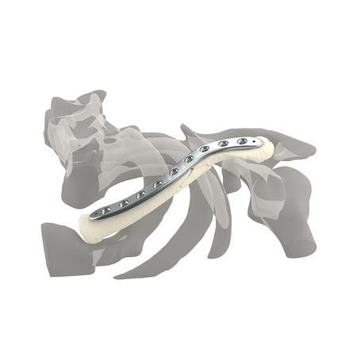
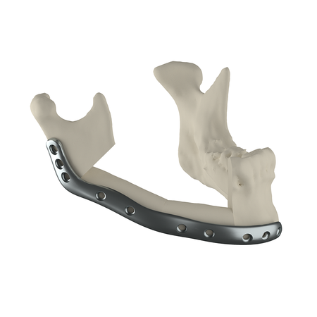
Meticuly Products
Titanium Bone products
1. Skull (Cranioplasty Solution)
2. Facial bone (Mid-Face Reconstruction)
3. Eyes socket bone (Oculoplastic Reconstruction)
4. Mandibular bone (Mandible Reconstruction)
5. Elbow bone (Elbow Solution)
6. Fingerbone (Hand Solution)
7. Collarbone (Clavicle Reconstruction)
2/2021
ITCS335_Introduction To E-Business Systems
2/2021

Slide 8

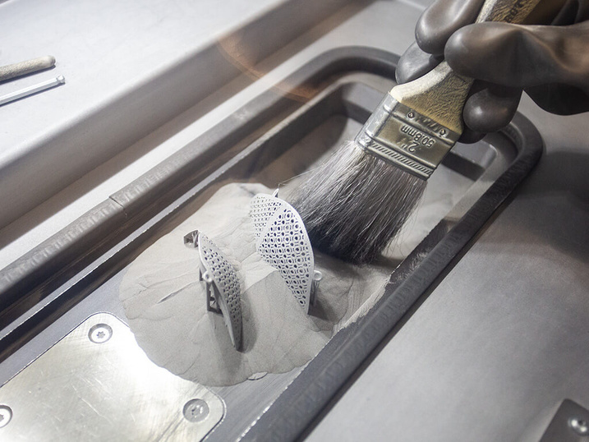
Highlight Features
Use AI technology to create titanium implants
Advanced 3D printing technology
Meticulous Engineers
Ever Increasing Precision
2/2021
ITCS335_Introduction To E-Business Systems
2/2021

Slide 9
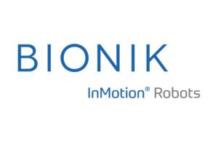


Competitor of METICULY
Bionik Labs
Aether Biomedical
Aditus Medical GmbH
2/2021
ITCS335_Introduction To E-Business Systems
2/2021

Slide 10

COMPETITOR ANALYSIS
PET ME!
Features
Meticuly
Aditus Medical GmbH
Aether Biomedical
Bionik
Labs
Medical surgery
products
Equipment for
specific use
Available
worldwide
Using AI technology in
surgery and its product
Wide range of
materials and services
Having
special product
2/2021
11
ITCS335_Introduction To E-Business Systems
2/2021

Slide 11

Strengths
PET ME!
S
Engineers with particular experience methodically develop and produce.
By collaboration with surgeons in a wide range of fields, so Meticuly can create titanium implant devices with greater precision as a result of this.
Muticuly is capable of producing strong titanium prosthetic bones with excellent mechanical properties.
Using AI technology to create titanium implants.
Cooperation with leading hospitals in various countries.
Using of the titanium implant.
Weaknesses
W
Titanium prosthetic bone is expensive compared
to other artificial bone materials.
2/2021
13
ITCS335_Introduction To E-Business Systems
2/2021

Slide 12
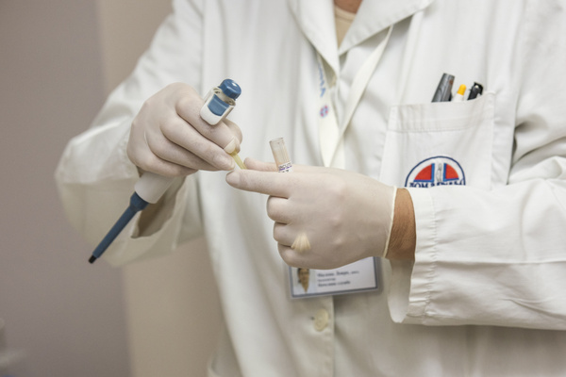


Opportunities
PET ME!
O
Since it is a specialized business, there are not many competitors.
The average annual number of patients required to have surgery statistic is high.
Deep tech trends are growing, so Meticuly might get more funding from these advantages.
By using 3d printing technology, more new products can be produced.
Threats
T
Many startups are interested in the MedTech-medical industry.
Cost increases, there is always the possibility that business and material costs will rise.
2/2021
14
ITCS335_Introduction To E-Business Systems
2/2021

Slide 13
Channels to interact
between the business
Customers can contract with Meticuly via
Meticuly cooperates with doctors and hospitals worldwide
Social Media
- Facebook, LinkedIn: Meticuly
- Line: @meticuly
- Email: info@meticuly.co.th
Meticuly Website: https://www.meticuly.com
2/2021
ITCS335_Introduction To E-Business Systems
2/2021

Slide 14
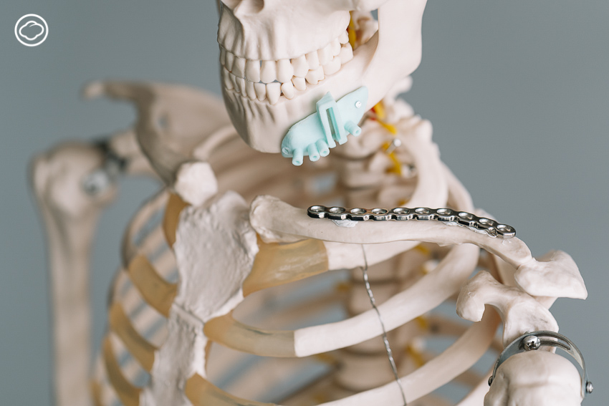
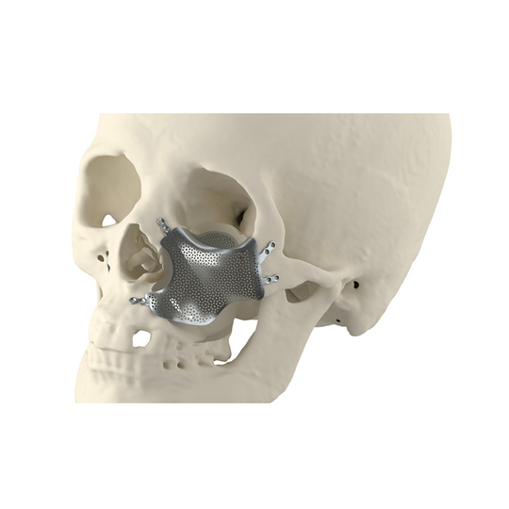
Revenue Model
Meticuly has income comes from the sale of products and product design services.
In addition, income comes from working in collaboration with doctors and hospitals.
2/2021
ITCS335_Introduction To E-Business Systems
2/2021

Slide 15
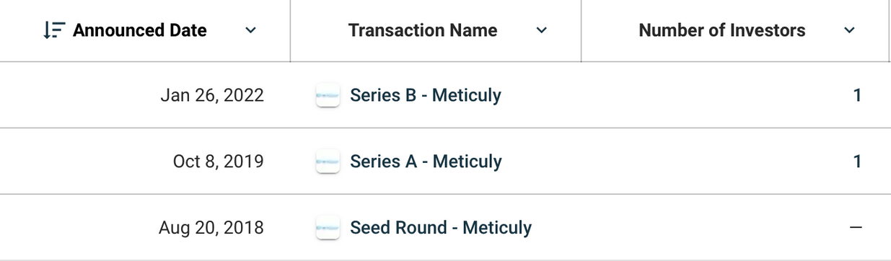
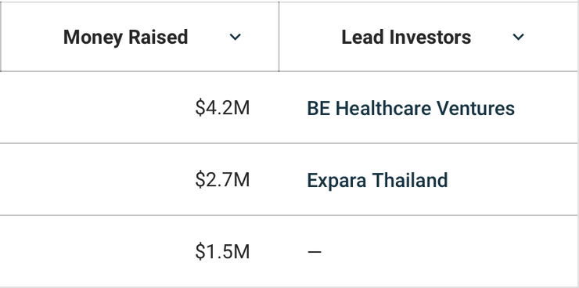
Funding
Meticuly has raised a total of $8.3M in funding over 3 rounds. Their latest funding was raised on Jan 26, 2022 from a Series B round.
With 2 investors which are BE Healthcare Ventures(Series B) and Expara Thailand(Series A) are the most recent investors.
2/2021
ITCS335_Introduction To E-Business Systems
2/2021

Slide 16

Thank You
Meticuly
2/2021

